Slide 1
WORLD OF LASERS
Laser Application: Scientific Area

Slide 2
SCIENTIFIC AREA
Laser is applied in many scientific areas. Particularly in biological and medical research, optical tweezers can be used for trapping and manipulating small particles, such as bacteria or parts of living cells.

Slide 3
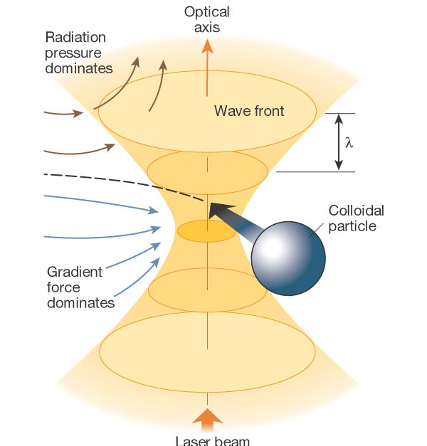
OPTICAL TWEEZER

Slide 4
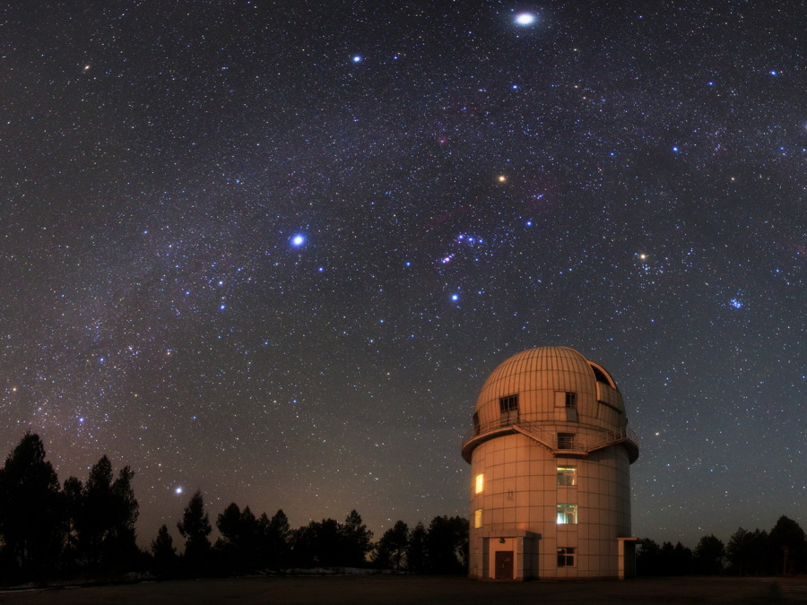
ASTRONOMICAL OBSERVATORIES
Lasers allow researchers to increase image resolution substantially even in cases where a sufficiently close-by natural guide star is not available.

Slide 5
?
WELL DONE!
Move on to the next laser application...
ENERGY!

